Slide 1
Data Structure IT-2101
Dr. Mohammad Abu Yousuf
yousuf@juniv.edu

Slide 2
Book References
Textbook:
Schaum Series Data Structures
By Seymour Lipschutz
Data Structure and Algorithm
By Alfer V. Aho, John E. Hoperoft, Jeffery D. Ullman
Data structures and algorithm analysis in C++
By Mark Allen Weiss (Fourth Edition)
Reference Book:
Algorithms
By Thomas H. Cormen

Slide 3
What is Data ?
Data:
Data are simply collection of facts and figures. Data are values or set of values. A data item refers to a single unit of values.
Data items that are divided into sub items are group items; those that are not are called elementary items. For example, a student’s name may be divided into three sub items – [first name, middle name and last name].
But the ID of a student would normally be treated as a single item.

Slide 4
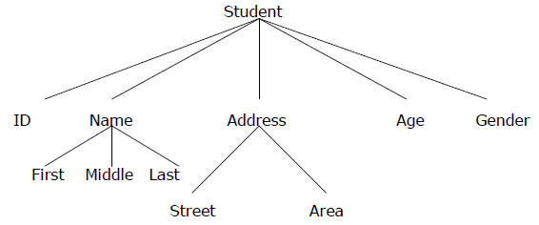
What is Data ?
(ID, Age, Gender, First, Middle, Last, Street, Area) are elementary data items, whereas (Name, Address ) are group data items.

Slide 5

Entity
Entity:
An entity is something that has certain attributes or properties which may be assigned values. The values themselves may be either numeric or non-numeric.
Example:
Entities with similar attributes (e.g. all the employees in an organization) form an entity set.

Slide 6
What is Data Structure?
A data structure is a particular way of storing and organizing data in a computer’s memory so that it can be used efficiently.
Data may be organized in many different ways; the logical or mathematical model of a particular organization of data is called a data structure.

Slide 7
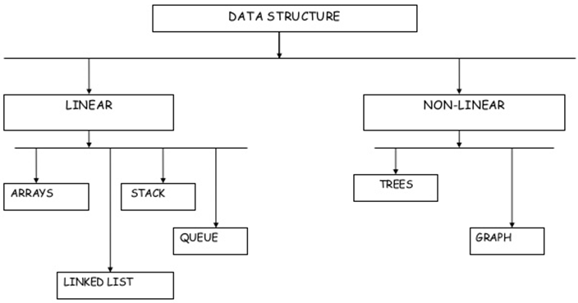
Categories of Data Structure

Slide 8
Categories of Data Structure
Linear Data Structure:
A data structure is said to be linear if its elements form any sequence.
Non-linear Data Structure:
This structure is mainly used to represent data containing a hierarchical relationship between elements.

Slide 9

Categories of Data Structure
Arrays:
The simplest type of data structure is a linear (or one dimensional) array.
Example:
A linear array A[8] consisting of numbers is pictured in following figure.

Slide 10
Categories of Data Structure
Linked List:
A linked list, or one way list is a linear collection of data elements, called nodes, where the linear order is given by means of pointers.
Each node is divided into two parts:
The first part contains the information of the element/node.
The second part contains the address of the next node (link /next pointer field) in the list.

Slide 11
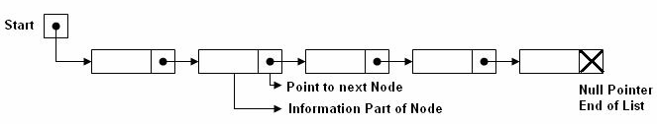
Categories of Data Structure
Example:
There is a special pointer Start/List contains the address of first node in the list. If this special pointer contains null, means that List is empty.

Slide 12
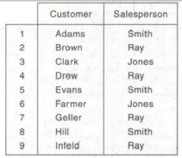
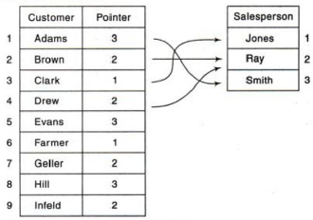
Categories of Data Structure
Example:

Slide 13
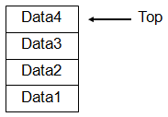
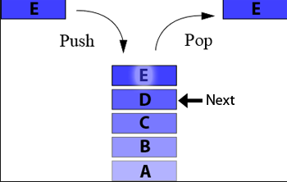
Categories of Data Structure
Stacks:
Collection with access only to the last element inserted.
Last in first out (LIFO)
insert/push
remove/pop
top

Slide 14
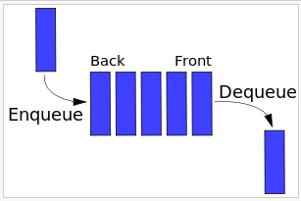
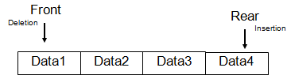
Categories of Data Structure
Queue:
Queue is an abstract data structure. Queue is opened at both end. One end is always used to insert data (enqueue) and the other is used to remove data (dequeue)
Last in last out or first in first out (FIFO)
front, rear
priority queues

Slide 15
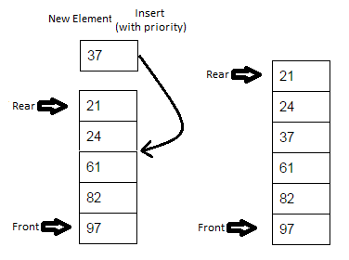

priority queue
A priority queue is an abstract data type which is like a regular queue , but where additionally each element has a "priority" associated with it.
In a priority queue, an element with high priority is served before an element with low priority

Slide 16
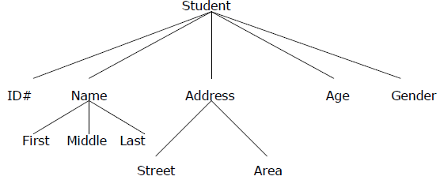
Categories of Data Structure
Tree:
Data frequently contain a hierarchical relationship between various elements.
The data structure which reflects this relationship is called a rooted tree graph or, simply, a tree.

Slide 17
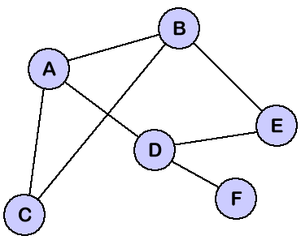
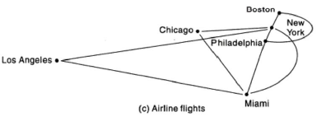
Categories of Data Structure
Graph:
Data sometimes contains a relationship between pairs of elements which is not necessarily hierarchical in nature, e.g. an airline flights only between the cities connected by lines. This data structure is called Graph.

Slide 18
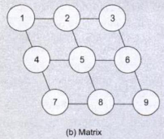

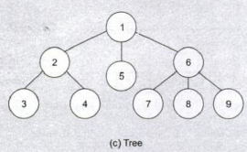
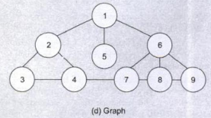
Different Types of Data Representation

Slide 19
What data structure to use?
Data structures let the input and output be represented in a way that can be handled efficiently and effectively.
array
Linked list
queue
tree
stack

Slide 20
Data Structures Operations
The data appearing in our data structures are processed by means of certain operations.
In fact, the particular data structure that one chooses for a given situation depends largely in the frequency with which specific operations are performed.

Slide 21
Data Structures Operations
The following four operations play a major role:
Traversing: accessing each record/node exactly once so that certain items in the record may be processed.
Searching: Finding the location of the desired node with a given key value, finding the locations of all such nodes which satisfy one or more conditions.
Inserting: Adding a new node/record to the structure.
Deleting: Removing a node/record from the structure.

Slide 22
Algorithm Design
An algorithm is a self-contained step-by-step set of operations to be performed.
Describe: in natural language / pseudo-code / diagrams / etc.
Criteria to follow:
Input: Zero or more quantities (externally produced)
Output: One or more quantities
Definiteness: Clarity, precision of each instruction
Effectiveness: Each instruction has to be basic enough and feasible
Finiteness: The algorithm has to stop after a finite (may be very large) number of steps

Slide 23
Algorithm Analysis
Space complexity
How much space is required
Time complexity
How much time does it take to run the algorithm

Slide 24
Algorithm Analysis
Space Complexity:
Its the amount of memory space required by the algorithm, during the course of its execution.
Space complexity must be taken seriously for multi-user systems and in situations where limited memory is available.
An algorithm generally requires space for following components :

Slide 25
Algorithm Analysis
✔ Instruction Space : Its the space required to store the executable version of the program. This space is fixed, but varies depending upon the number of lines of code in the program.
✔ Data Space : Its the space required to store all the constants and variables value.
✔ Environment Space : Its the space required to store the environment information needed to resume the suspended function.

Slide 26
Algorithm Analysis
Time Complexity:
Time Complexity is a way to represent the amount of time needed by the program to run to completion.
Often more important than space complexity
space available tends to be larger and larger
time is still a problem for all of us
Algorithms running time is an important issue.

Slide 27
Algorithm Analysis
Calculating Time Complexity:
Now the most common metric for calculating time complexity is Big O notation. This removes all constant factors so that the running time can be estimated in relation to N, as N approaches infinity.
In general you can think of it like this :
statement;
Above we have a single statement. Its Time Complexity will be Constant. The running time of the statement will not change in relation to N.

Slide 28
Algorithm Analysis
for(i=0; i < N; i++)
{
statement;
}
The time complexity for the above algorithm will be Linear. The running time of the loop is directly proportional to N.

Slide 29
Algorithm Analysis
for(i=0; i < N; i++)
{
for(j=0; j < N;j++)
{
statement;
}
}
This time, the time complexity for the above code will be Quadratic. The running time of the two loops is proportional to the square of N. When N doubles, the running time increases by N * N.

Slide 30
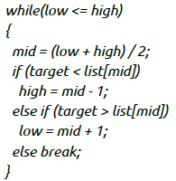
Algorithm Analysis
This is an algorithm to break a set of numbers into halves, to search a particular field.
Now, this algorithm will have a Logarithmic Time Complexity. The running time of the algorithm is proportional to the number of times N can be divided by 2 (N is high-low here). This is because the algorithm divides the working area in half with each iteration.

Slide 31
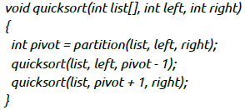
Algorithm Analysis
Taking the previous algorithm forward, above we have a small logic of Quick Sort (we will study this in detail later). Now in Quick Sort, we divide the list into halves every time, but we repeat the iteration N times(where N is the size of list).
Hence time complexity will be N*log( N ). The running time consists of N loops (iterative or recursive) that are logarithmic, thus the algorithm is a combination of linear and logarithmic.

Slide 32
Algorithm Analysis
Note:
In general, doing something with every item in one dimension is linear.
Doing something with every item in two dimensions is quadratic, and
Dividing the working area in half is logarithmic.

Slide 33
Algorithm Analysis
Time for an algorithm to run t(n):
A function of input. However, we will attempt to characterize this by the size of the input. We will try and estimate the WORST CASE, the BEST CASE, and the AVERAGE CASE.
Worst Case:
is the maximum run time, over all inputs of size n. That is, we only consider the "number of times the principle activity of that algorithm is performed".
Best Case:
In this case, we look at specific instances of input of size n. For example, we might get best behavior from a sorting algorithm if the input to it is already sorted.

Slide 34
Algorithm Analysis
Average Case:
Arguably, average case is the most useful measure.
Since the algorithm's performance may vary with different types of input data, hence for an algorithm we usually use the worst-case Time complexity of an algorithm because that is the maximum time taken for any input size.

Slide 35
Algorithm Analysis
Types of Notations for Time Complexity:
1) Big Oh denotes "fewer than or the same as" <expression> iterations (worst-case).
2) Big Omega denotes "more than or the same as" <expression> iterations.
3) Big Theta denotes "the same as" <expression> iterations.
4) Little Oh denotes "fewer than" <expression> iterations.
5) Little Omega denotes "more than" <expression> iterations.

Slide 36
Algorithm Analysis
Understanding Notations of Time Complexity with Example:
O(expression) is the set of functions that grow slower than or at the same rate as expression.
Omega(expression) is the set of functions that grow faster than or at the same rate as expression.
Theta(expression) consist of all the functions that lie in both O(expression) and Omega(expression).
Suppose you've calculated that an algorithm takes f(n) operations, where,
f(n) = 3*n^2 + 2*n + 4. // n^2 means square of n
Since this polynomial grows at the same rate as n^2, then you could say that the function f lies in the set Theta(n^2). (It also lies in the sets O(n^2) and Omega(n^2) for the same reason.)

Slide 37
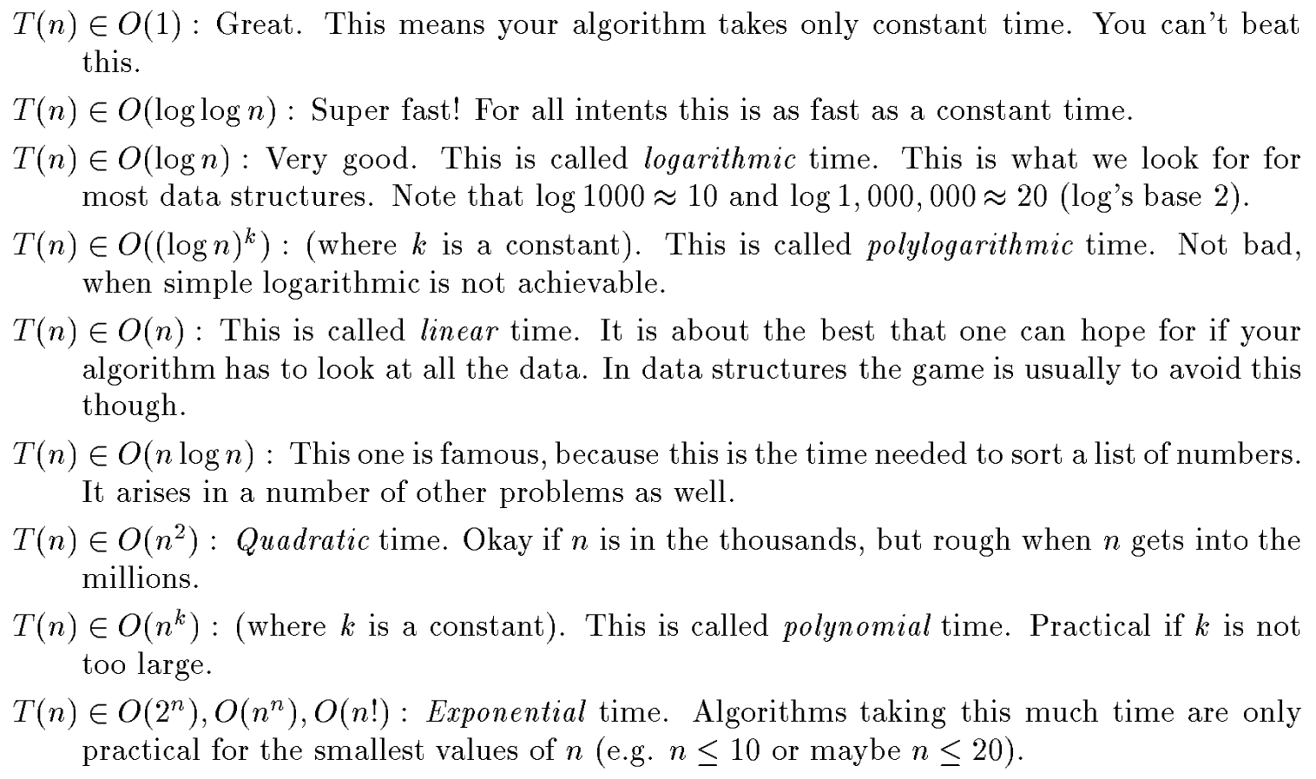
Algorithm Analysis

Slide 38
Thank You

